Slide 1

US Major Causes of Death (1900 – 2015)
Steve Bogdan, Dan Fox, Brian Reyes

Slide 2
Data
Centers for Disease Control and Prevention
Visualize 5 major causes of death in the United States from 1900-2015.
Stroke, heart disease, influenza/pneumonia, cancer, and accidents.
CDC overview site: https://data.cdc.gov/NCHS/NCHS-Age-adjusted-Death-Rates-for-Selected-Major-C/6rkc-nb2q
Dataset link: https://data.cdc.gov/NCHS/NCHS-Age-adjusted-Death-Rates-for-Selected-Major-C/6rkc-nb2q.json

Slide 3
Seemed Simple Enough…
There were only had 3 columns of data
Picked 3 different visualizations to build a dashboard

Slide 4
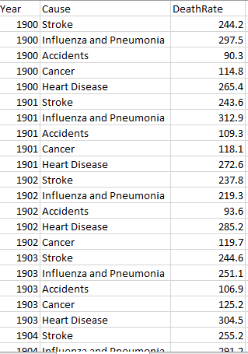
Original Data Format

Slide 5
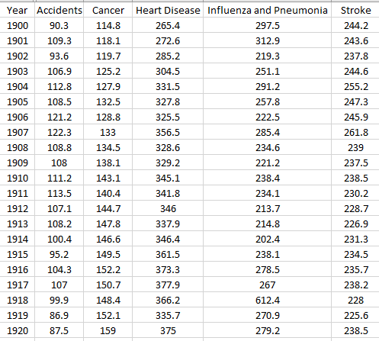
Desired Data Format

Slide 6

New Packages Incorporated

Slide 7
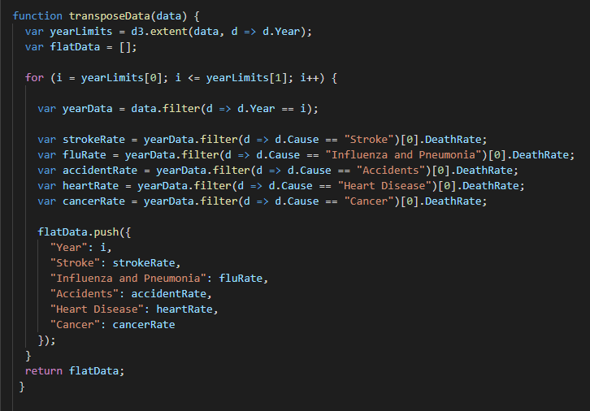
Data Transformation

Slide 8

Stack & Looping (Nesting)

Slide 9
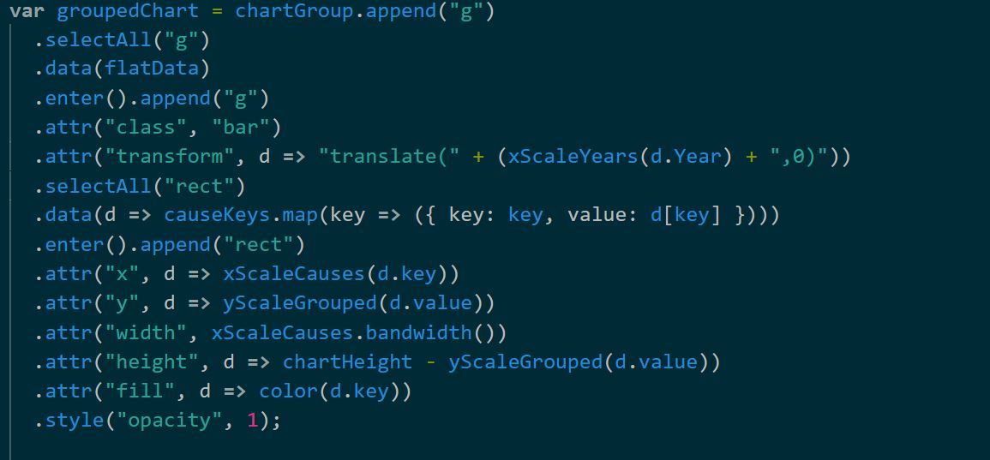
Inner Data Selection (Subset)

Slide 10

Highlighting Data

